Slide 1
S.T.A.R.
Success Through Arithmetic and Reading
S.T.A.R. is Title I funded program designed to remediate students in the areas of reading and mathematics.
Mission
The Success Through Arithmetic and Reading (S.T.A.R.) program’s role is to increase the knowledge base and confidence level of 7th and 8th grade students in the area of arithmetic and reading through rigorous and engaging lessons utilizing current technologies and collaboration.

Slide 2
S.T.A.R.
Success Through Arithmetic and Reading
Implementation
October-December: Teachers and Parents Conference about Specific Needs related to the Student’s Academic Progress-A S.T.A.R. Application is completed for students who are identified as needing assistance in Reading and/or Math.
January-April: Students who completed the S.T.A.R. Application are invited to attend Saturday School Sessions related to increasing the knowledge and skills related to Reading and/or Math. These sessions are taught by highly-qualified Reading and Math teachers from YMS and incorporate small group and individualized instruction utilizing sound teaching practices and technology.
April: Students complete the administration of the Criterion-Referenced Competency Test (CRCT)

Slide 3
STAR Student Survey
2012-2013
Student Survey conducted
Saturday, March 23, 2013 and
Saturday, April 13, 2013.
A total of 37 students completed the survey.

Slide 4

S.T.A.R.
Success Through Arithmetic and Reading
Student Feedback
In order to continually improve the implementation of knowledge and skills related to S.T.A.R., we utilize student input and feedback on an annual basis.

Slide 5
Only 46% of students surveyed like the idea of having STAR after school.

Slide 6
A total of 73% of students surveyed like the idea of having STAR on Saturday.

Slide 7
Only 35% of students surveyed like the idea of having 7 Saturdays in a row.

Slide 8
A total of 81% of students surveyed like the idea of having STAR spread out over several months.

Slide 9
S.T.A.R.
Success Through Arithmetic and Reading
Goals
Each year, we review specific goals related to S.T.A.R. Establishing consistent student attendance is paramount to reaching our success.
Therefore, we worked with Communities In Schools (CIS) last year to create an incentive program based on student attendance in S.T.A.R.

Slide 10
A total of 78% of students surveyed felt the Gift Card Raffle encouraged them to attend STAR.

Slide 11
A total of 86% of students surveyed would like to see Beats (or like items) raffled.

Slide 12
A total of 97% of students surveyed feel offering coupons, passes and raffle tickets during class helped to keep them focused.

Slide 13
A total of 89% of students surveyed like the idea of a warm breakfast to begin STAR.

Slide 14
A total of 75% of students surveyed like the idea of a having cereal bars, etc. for snack.

Slide 15
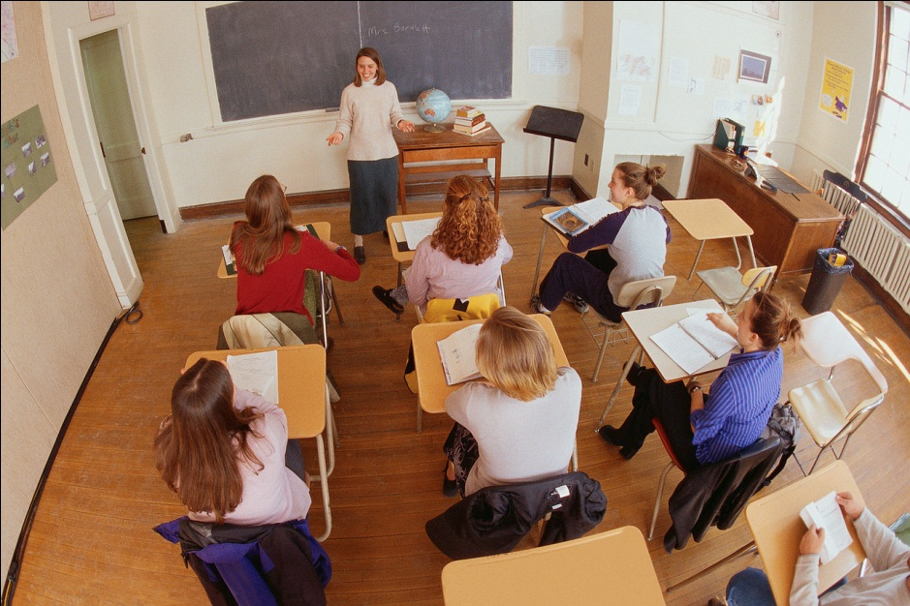
S.T.A.R.
Success Through Arithmetic and Reading
Goal Results:
The result of our 1st year of attendance initiatives yielded a result of 6 additional students attending S.T.A.R. each Saturday from the previous year.

Slide 16

S.T.A.R.
Success Through Arithmetic and Reading
Direction for the Future
What would our S.T.A.R. students like to see included on Saturdays?

Slide 17
A total of 78% of students surveyed want help with homework, missing work, and school work.

Slide 18



S.T.A.R.
Success Through Arithmetic and Reading
Success
How successful do the students feel the S.T.A.R. program is?

Slide 19
A total of 73% of students surveyed feel stronger in Reading as a result of STAR.

Slide 20
A total of 95% of students surveyed feel stronger in Math as a result of STAR.

Slide 21
A total of 89% of students surveyed feel more confident about taking the CRCT.

Slide 22
A total of 84% of students surveyed feel more confident about school.

Slide 23

S.T.A.R.
Success Through Arithmetic and Reading
The Best Compliment a S.T.A.R. student could offer…

Slide 24
A total of 91% of students surveyed would suggest STAR to someone who is looking for help with the CRCT.

Slide 25
The S.T.A.R. program is successful each year because of the students, their families, the staff at Youth Middle School, and local sponsors.
Thank you for your time and efforts in helping the students of YMS meet their goals.
Please feel free to contact me at tthrailkill@walton.k12.ga.us if I can ever be of assistance to you.

